Slide 1
Vehicle Insurance Claim Fraud Detection Using Machine Learning
Scott Ye & Summer Xiao

Slide 2
Background of Vehicle Insurance Fraud
Insurance fraud is a deliberate deception against an insurance company or agent for the purpose of financial gain.
Auto insurance fraud ranges from misrepresenting facts on insurance applications and inflating insurance claims to staging accidents and submitting claim forms for damage that never occurred, to false reports of stolen vehicles.

Slide 3
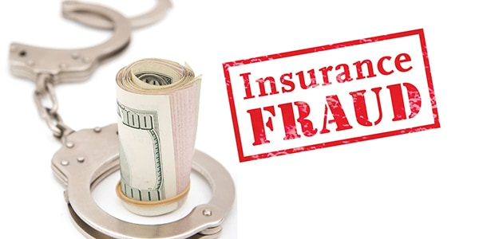
Our goal is to build models that can detect auto insurance claims fraud.

Slide 4
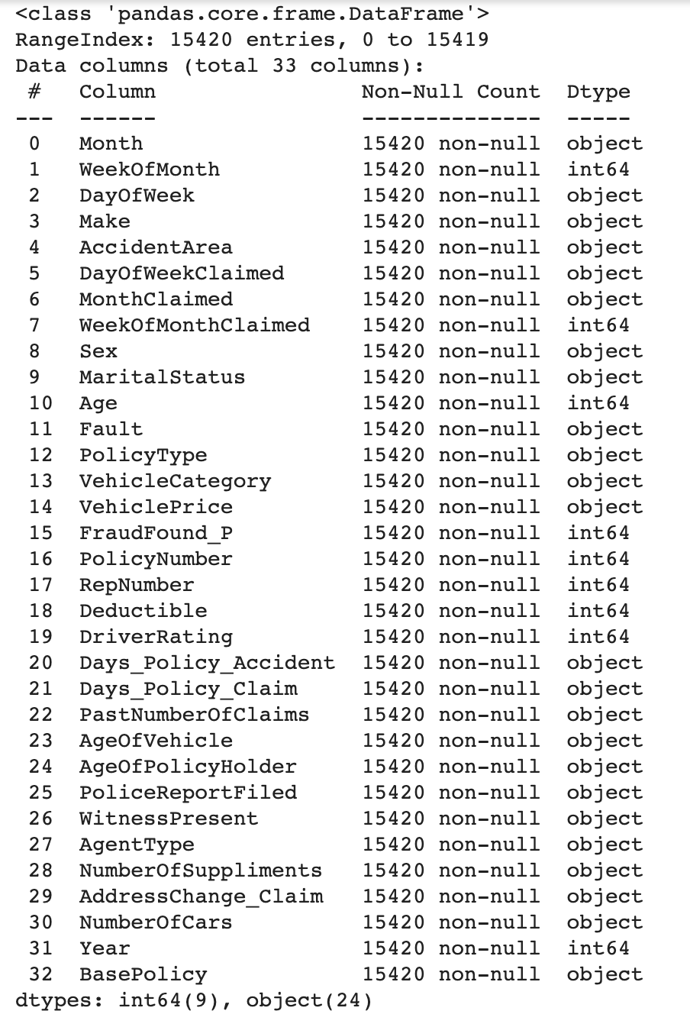
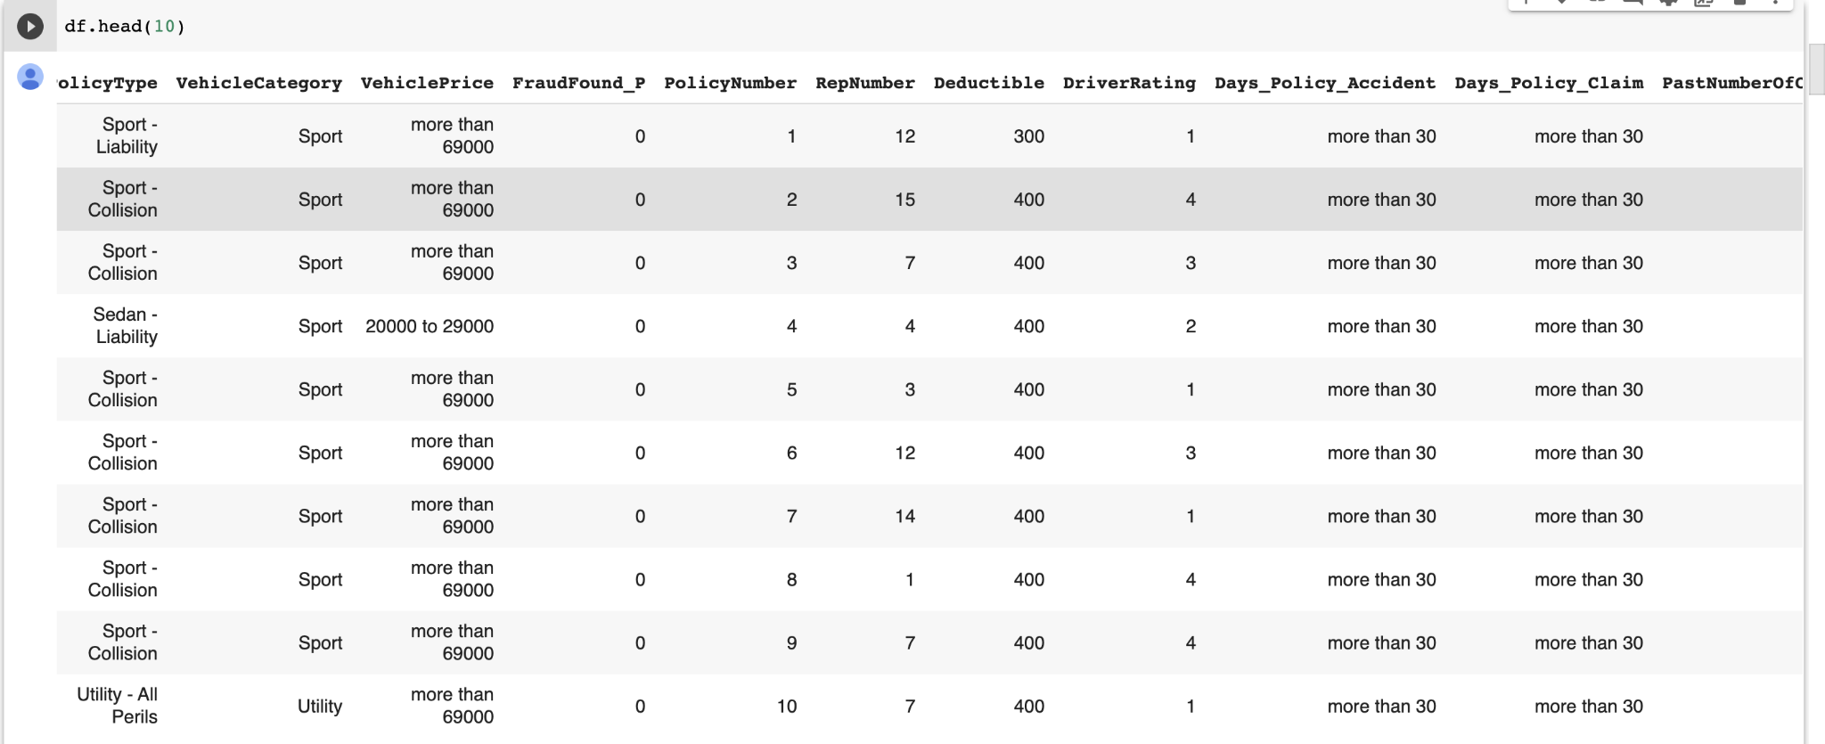
Load & Preprocess the Data
Data from Oracle
15420 samples, 33 features

Slide 5
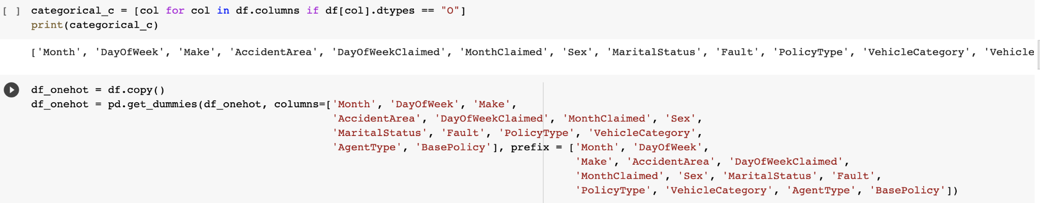
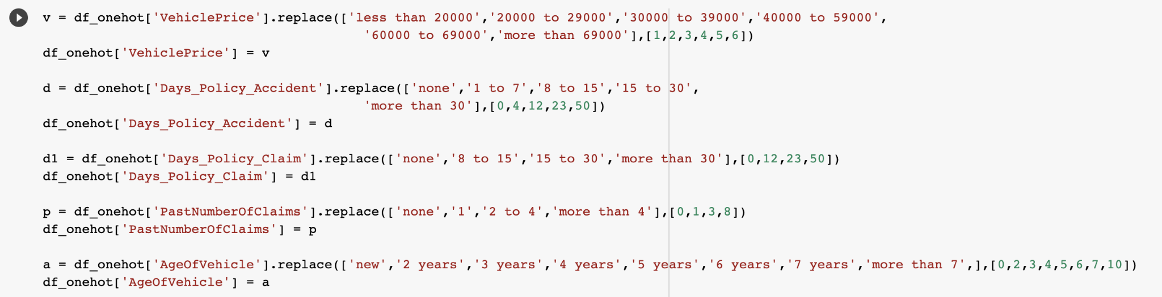
One-hot coding
categorical→numerical
……

Slide 6
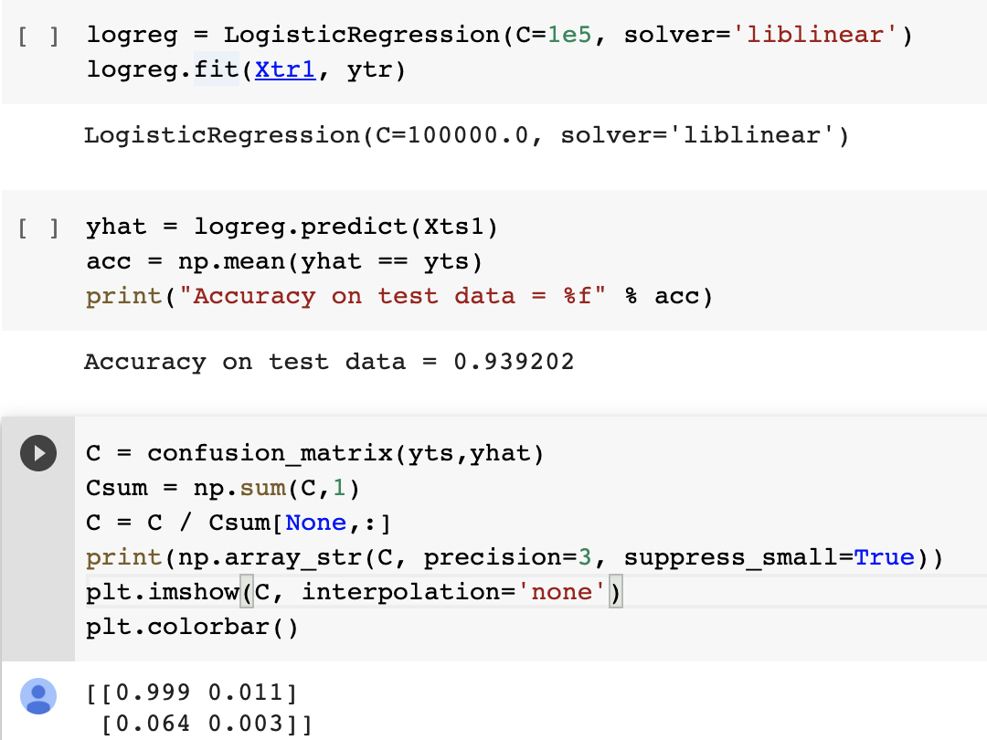
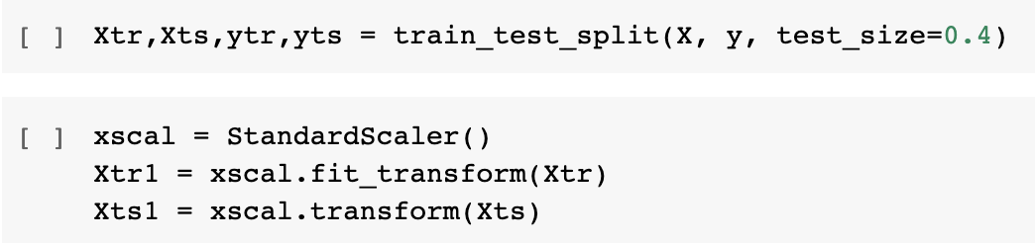
Implementing Classification using Logistic Regression

Slide 7
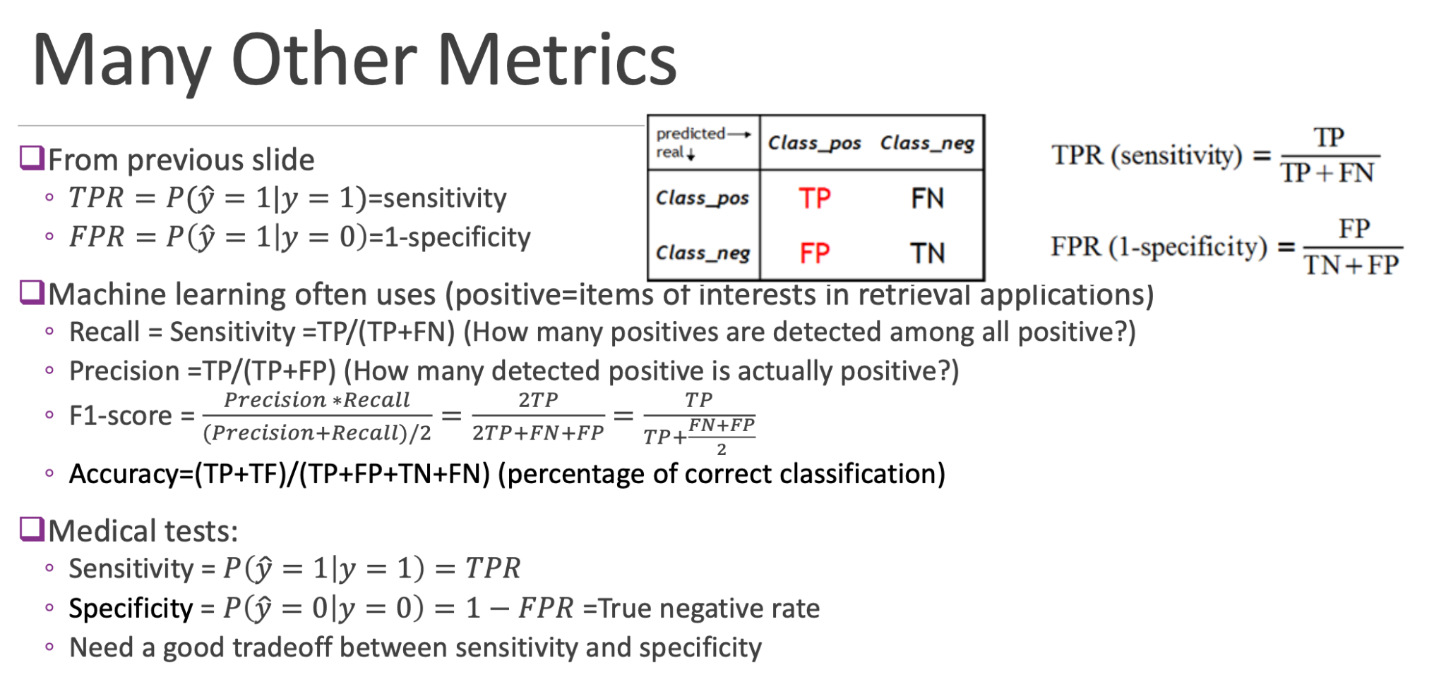

Slide 8
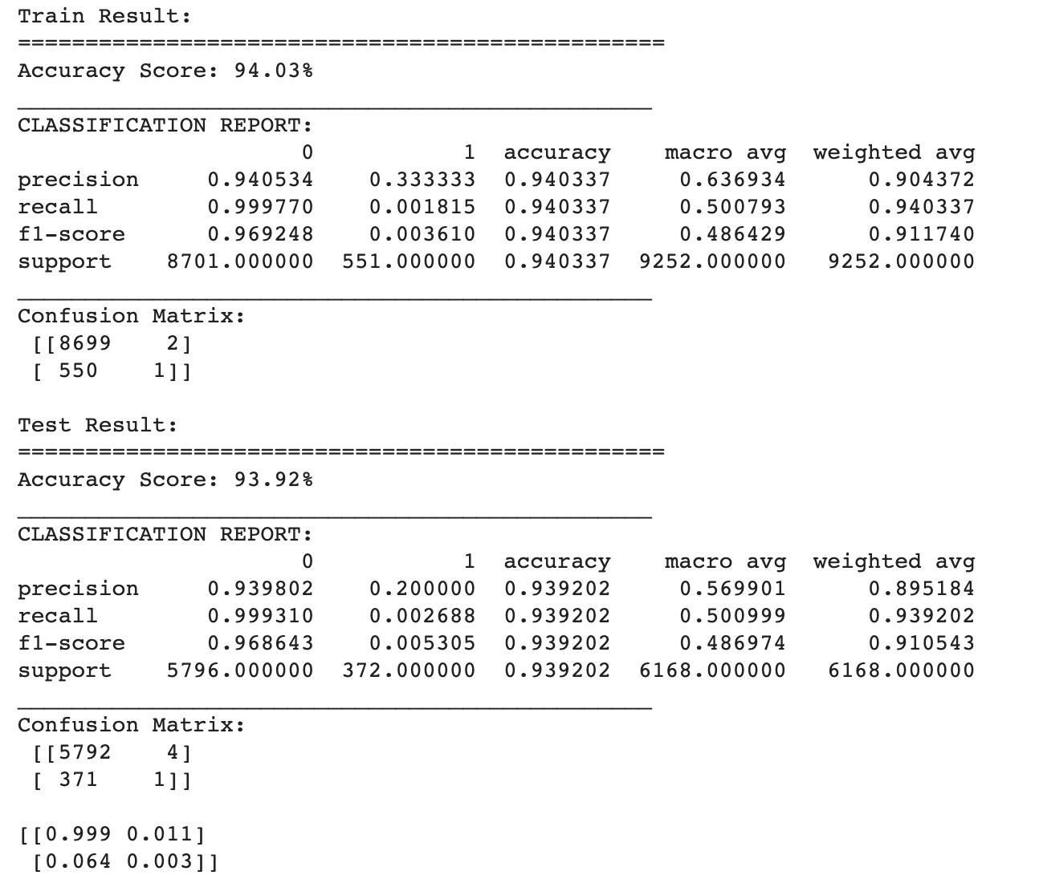

Slide 9
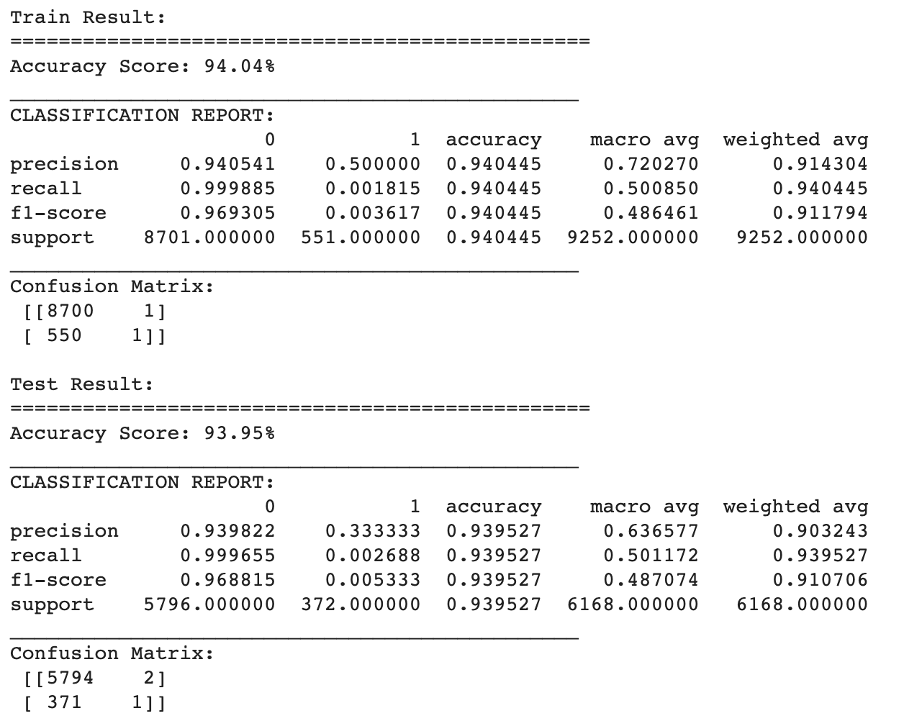
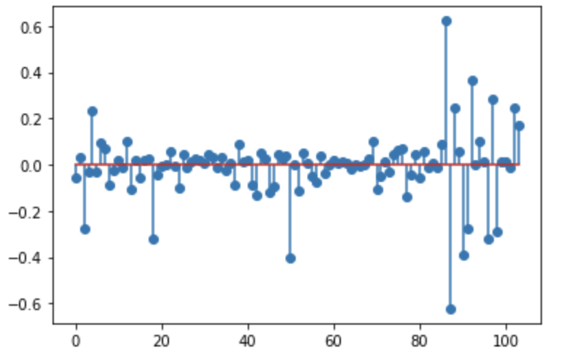
L1 regularization

Slide 10
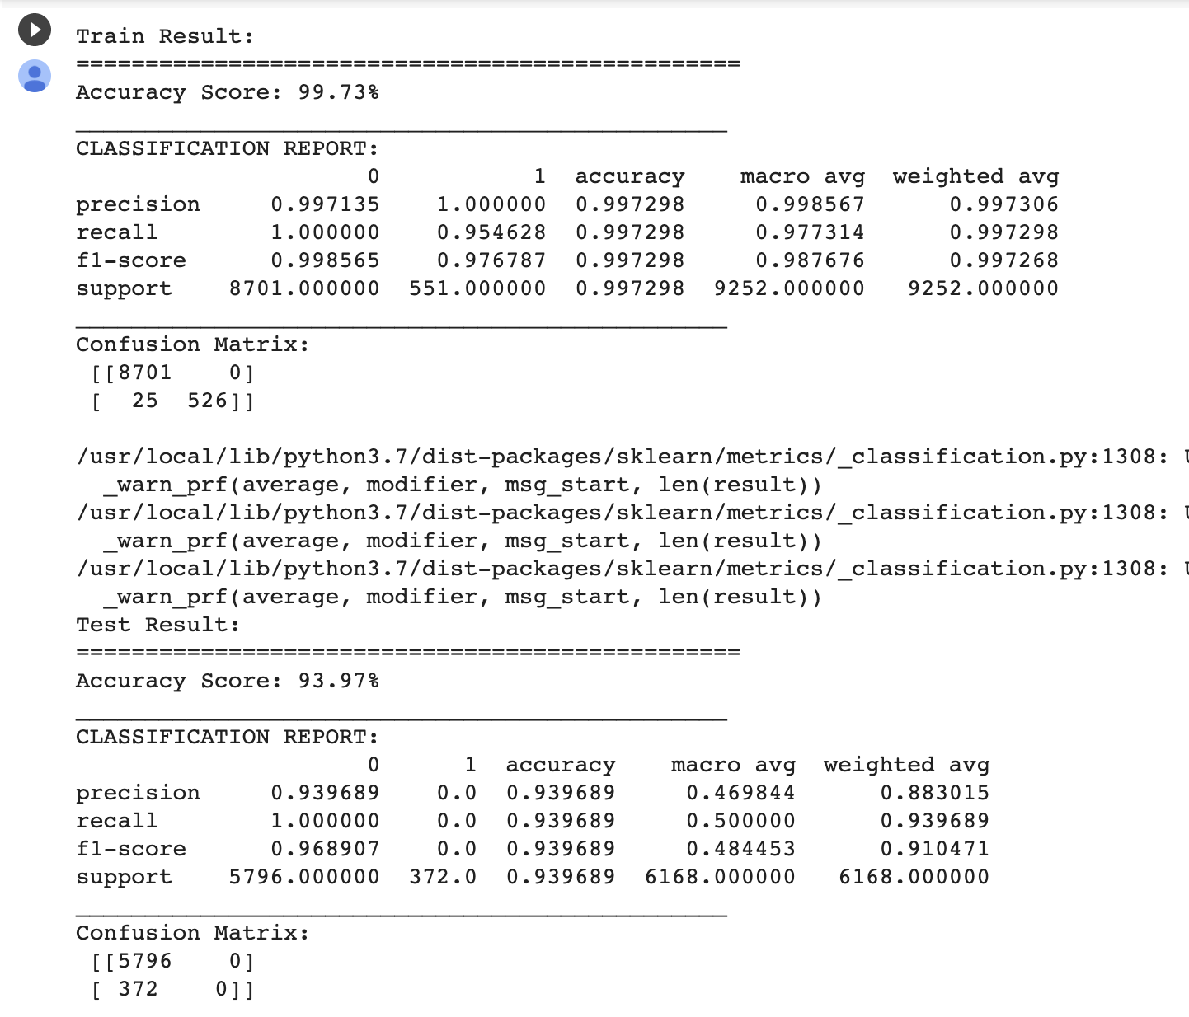
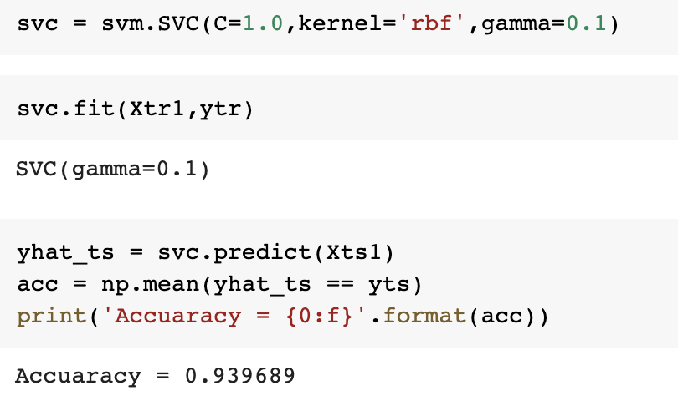
Implementing Classification using SVM

Slide 11


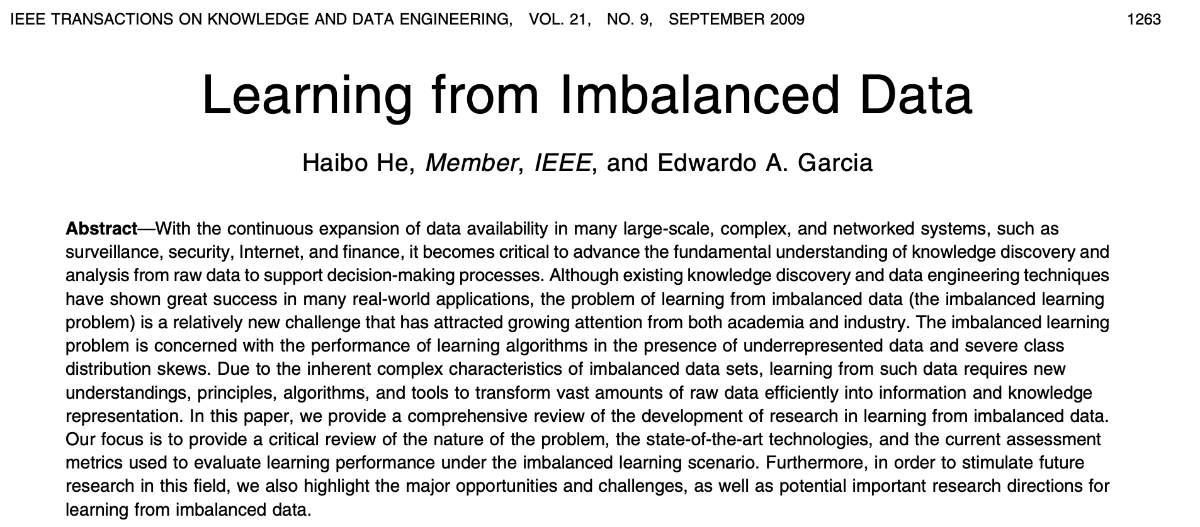
(923 positive vs. 14497 negative cases)
Imbalanced Sample
Model Evaluation Metrics
Cost-sensitive learning
Resampling
A simple oversampling model
Other oversampling models
Intuitively, it is much more difficult for an ML model to correctly learn all the characteristics of the minority class given its smaller sample size and skewed class distribution. A naive model can achieve reasonable accuracy by simply predicting the majority class in all cases.

Slide 12
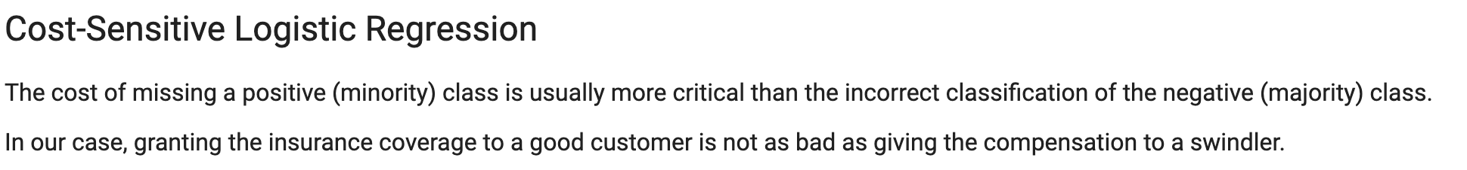
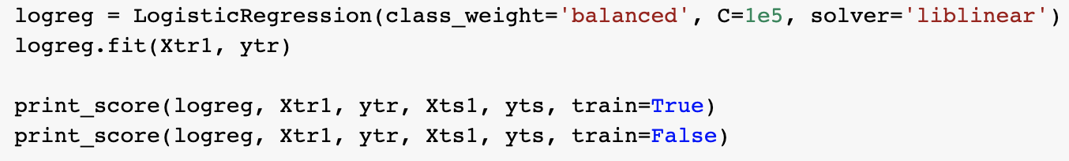
Cost-Sensitive Learning
This parameter penalizes the model less for errors made on examples from the majority class and penalizes the model more for errors made on examples from the minority class.

Slide 13
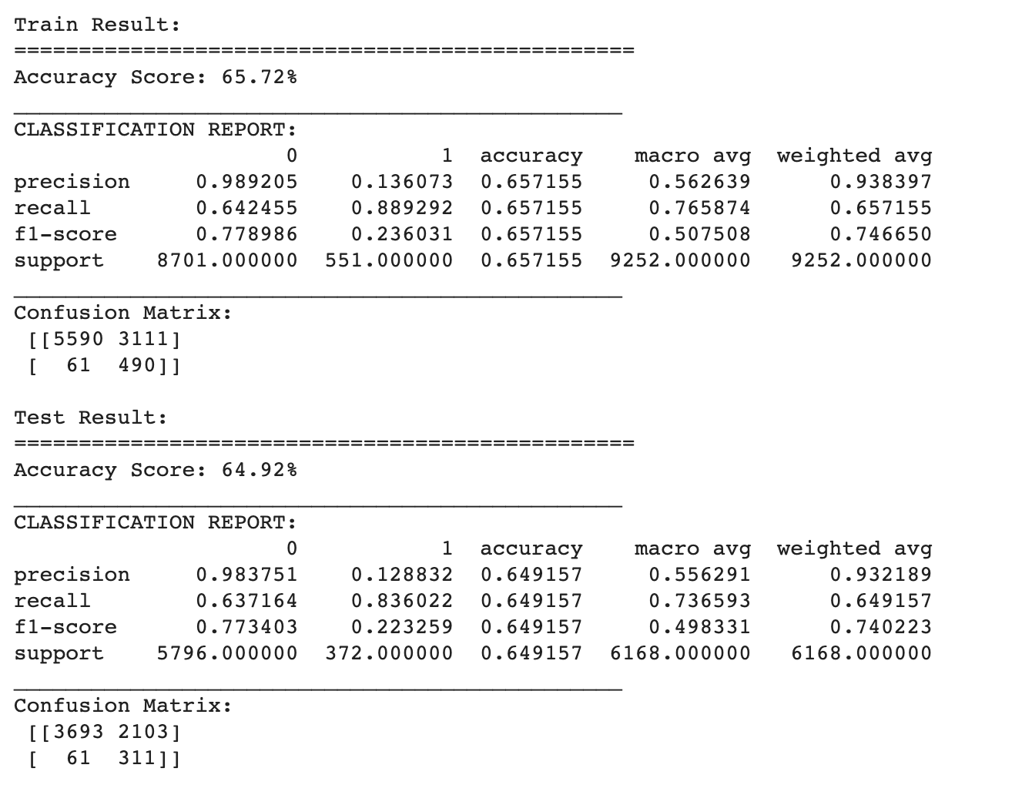

Slide 14
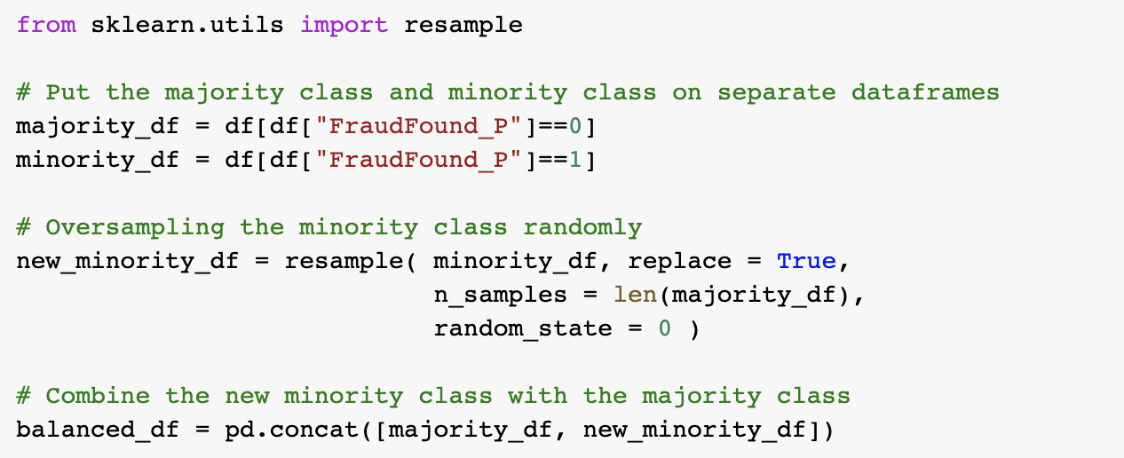
A simple oversampling method by hand
We keep randomly duplicating the minority samples until its sample size is the same as the majority sample size.

Slide 15
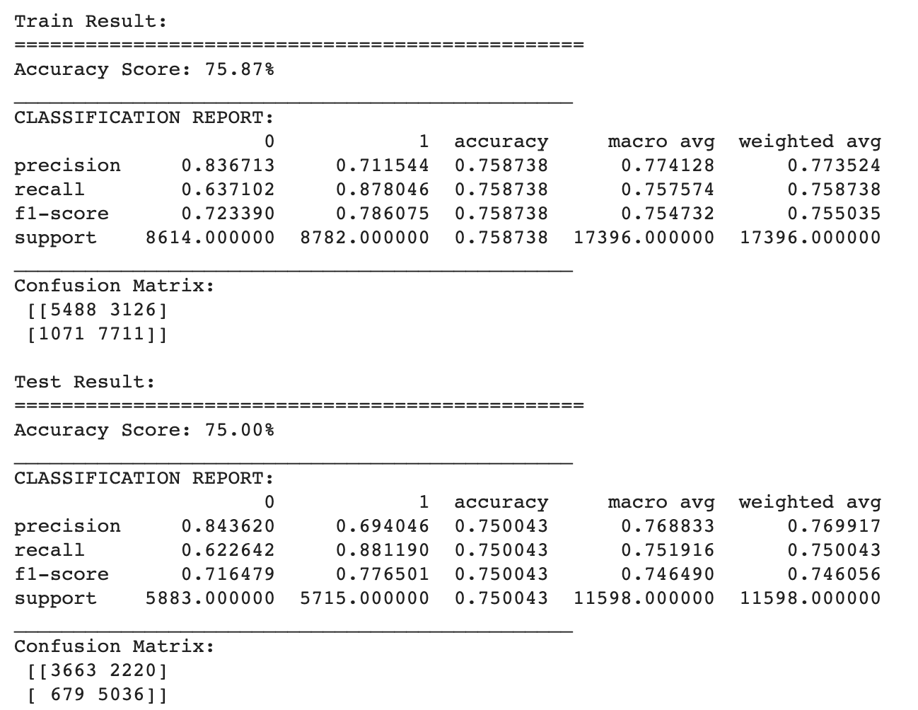
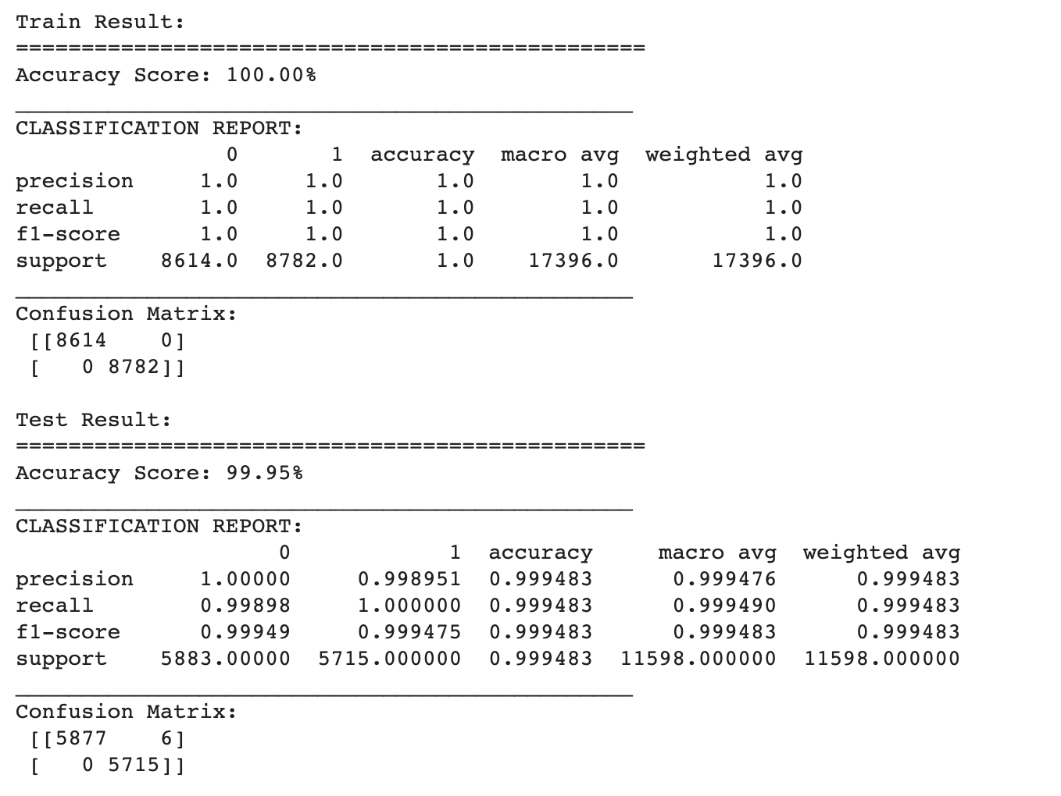
Logistic Regression
SVM

Slide 16
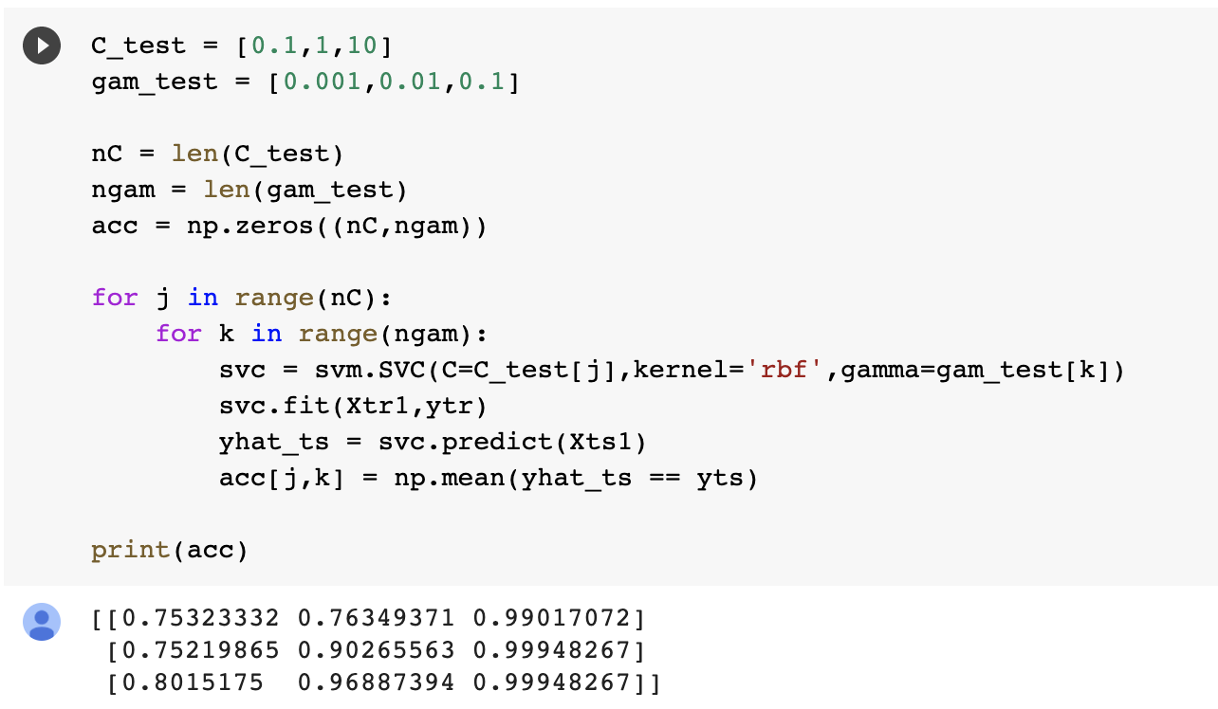
SVM with parameter selection
C = 1/10, gamma = 0.1

Slide 17
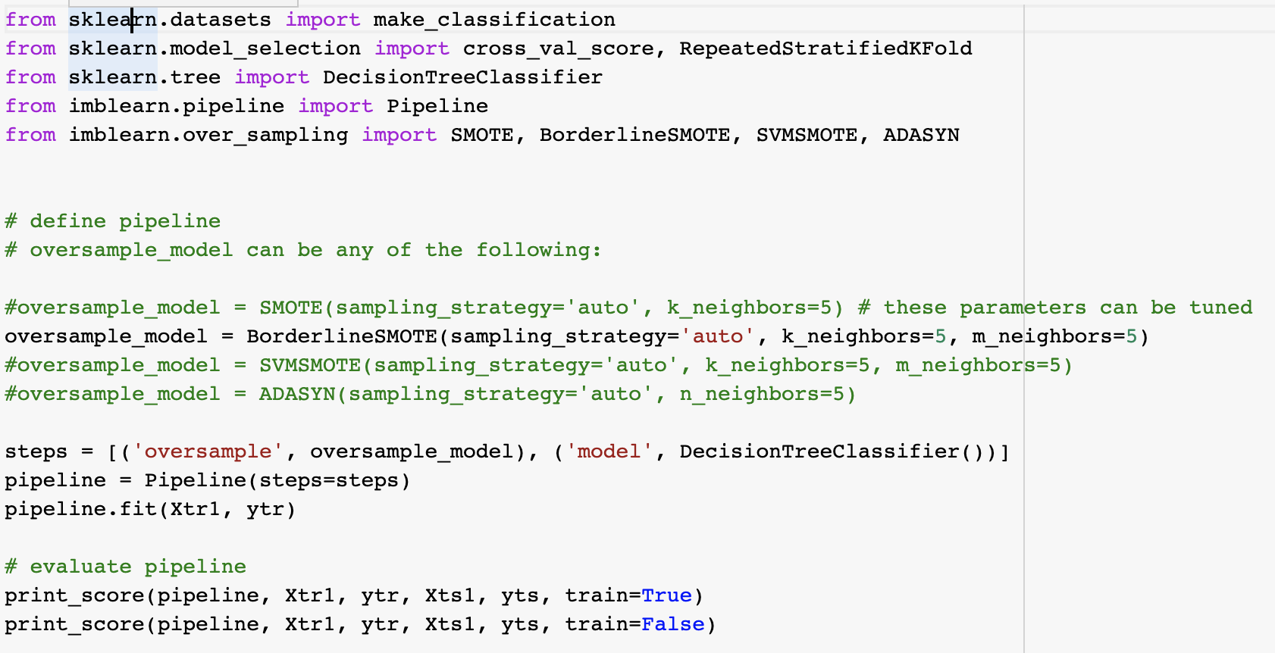
Other existing oversampling methods

Slide 18
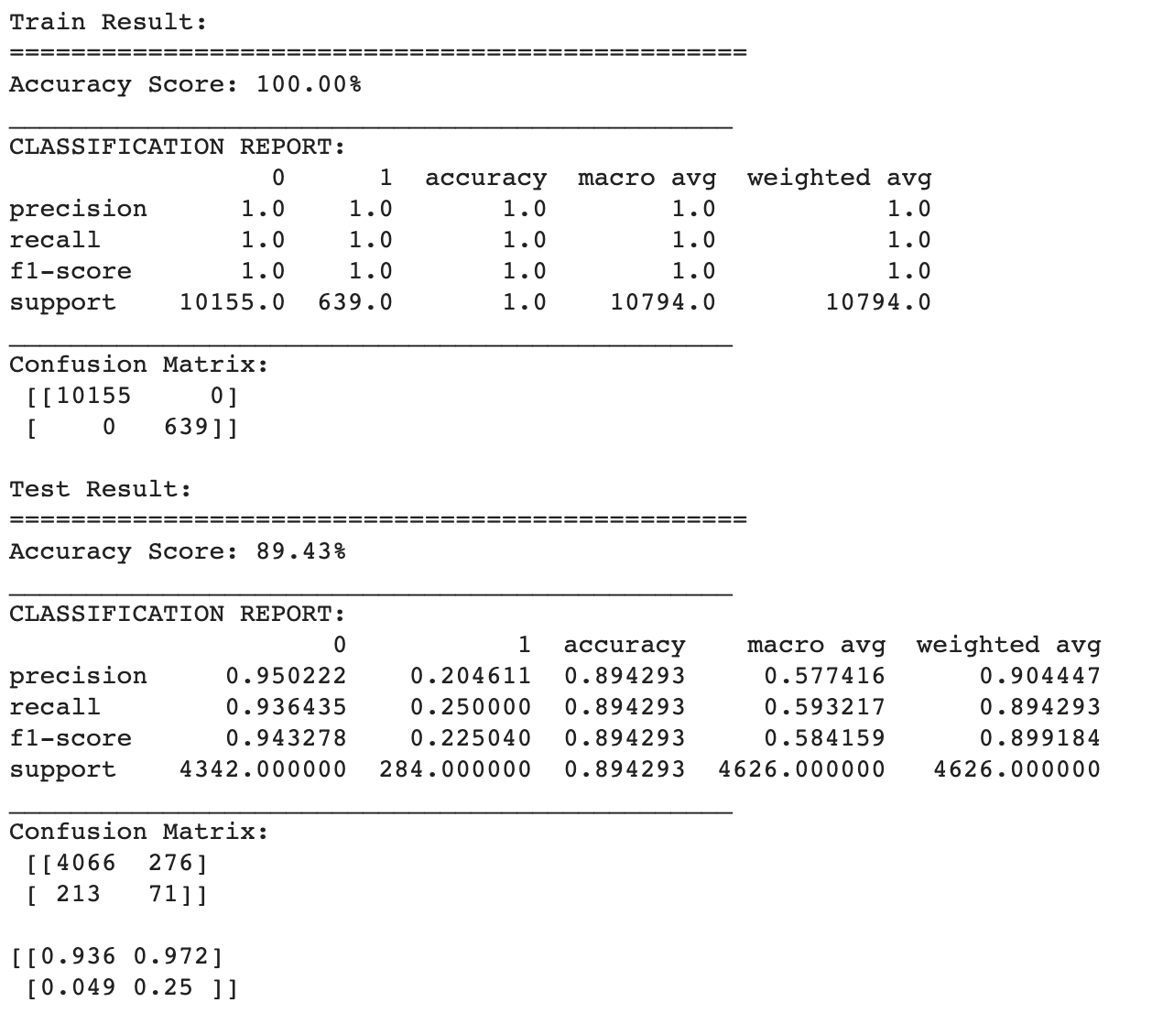

Slide 19
Through logistic regression wiz L1 regularization, the biggest factors that predict fraud are Policy Holder & PolicyType - Sedan Liability.
After resampling, we partially reduce the false negative error, but it sometimes miscategorizes non-fraud cases to fraud cases. As a result, the insurance provider can be more confident resolving claims with predicted non-fraud cases.
Conclusions:

Slide 20
We should have been randomly duplicating the minority samples until its sample size is the same as the majority sample size in the training set. Then we test the model on the unchanged test set to avoid high similarity between train and test sets.
We suspect overfitting in the training set.
We also want to try on other packages such as COSTCLA for cost-sensitive learning and synthetic sampling method.
Improvements:

Slide 21
Reference
He, Haibo, and Edwardo A. Garcia. "Learning from imbalanced data." IEEE Transactions on knowledge and data engineering 21.9 (2009): 1263-1284.

